Slide 1
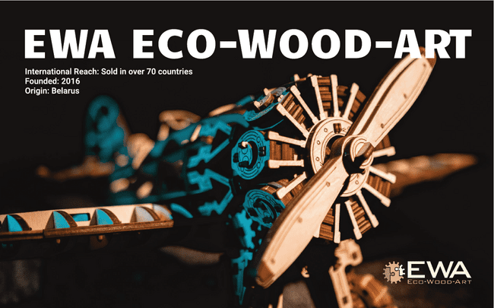

Slide 2

ABOUT THE COMPANY
Konglomerat LLC (EWA Eco-Wood-Art™) is a Belarusian manufacturer of mechanical 3D constructors, toys, souvenirs, and wooden interior products.
The company was founded in 2016 and is located in Pinsk, Brest region.
Over 350 developed models
Own trademark EWA™, registered in key markets (EU, USA, China, etc.)
Export-oriented production

Slide 3



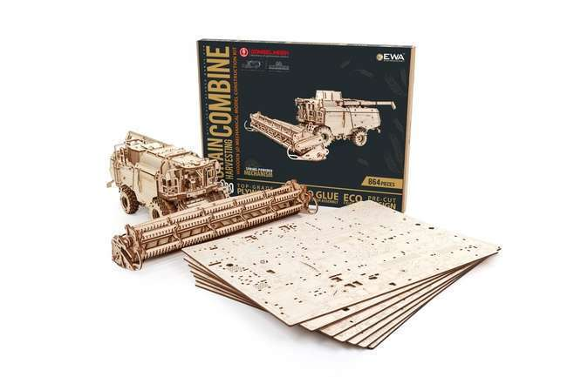
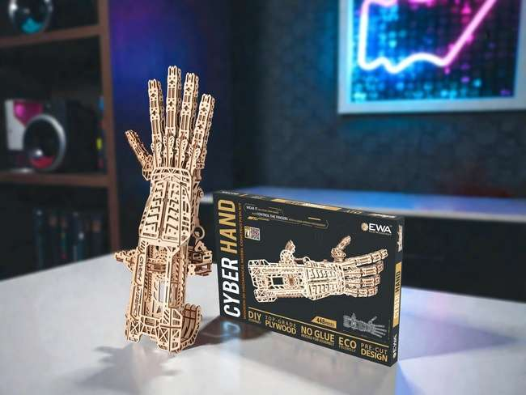
PRODUCT DESCRIPTION
Since 2016, LLC Konglomerat has developed and launched over 350 original models of various themes and complexity levels made from high-quality plywood. The products are designed for teenagers aged 14+ and adults, with different levels of difficulty.
They are used not only for entertainment purposes, but also as interior decor, souvenirs, and corporate gifts. Each package includes instructions in multiple languages.
HS Code: 9503003900

Slide 4
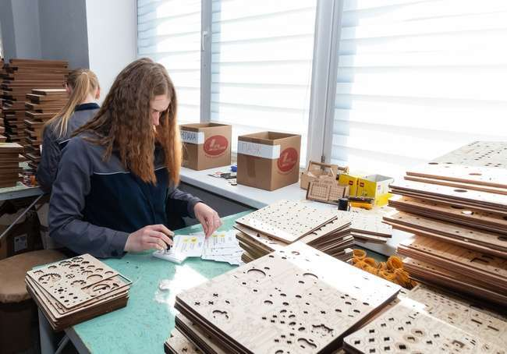
PRODUCTION AND TECHNOLOGY
Production is based on the use of high-precision laser equipment and modern wood-processing technologies.
In-house model and design development
Use of natural, eco-friendly materials
High precision of parts and assembly
Multi-stage quality control
Quality management system oriented toward international markets

Slide 5
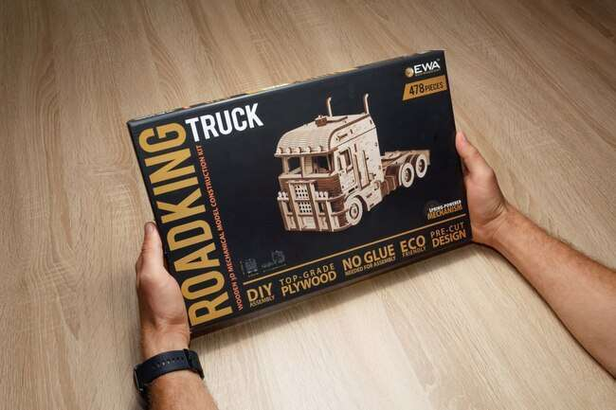
COMPETITIVE ADVANTAGES
Unique product: mechanics + DIY + design
In-house model development
Eco-friendly and safe
Wide range (350+ SKU)
Registered EWA™ brand in international markets
High margins for partners
No mandatory certification required in target markets
The products comply with general consumer product safety requirements.

Slide 6

EXPORT AND PARTNERSHIPS
The company is actively expanding its exports and collaborating with international partners.
Supplies to Europe, the USA, China, and other countries
Cooperation with distributors, retail chains, and e-commerce platforms
Products adapted for international markets (multilingual packaging)
Open to new partnerships and expanding its global presence

Slide 7

PRICES, PAYMENT AND SERVICE
Pricing:
Provided upon request (assortment of over 350 items)
Currency:
EUR / CNY / RUB
Payment terms:
Prepayment
Individual terms available for long-term cooperation
Additional:
Technical and service support worldwide
Open to long-term international cooperation

Slide 8
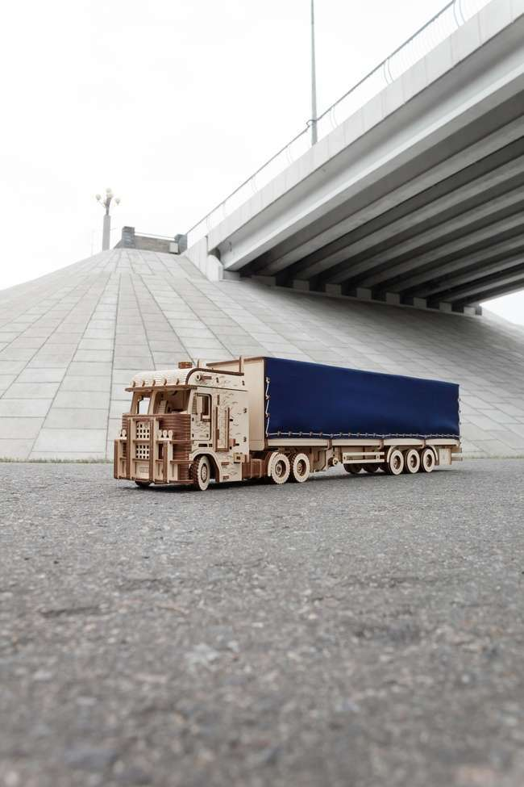
TERMS OF COOPERATION AND LOGISTICS
Sales terms:
Direct negotiations with the manufacturer
Delivery terms (Incoterms):
FCA / CPT / DAP / FOB / CFR (negotiated individually)
Key parameters:
Minimum order: €5,000 (MOA)
Delivery time: depends on order volume and destination
Storage conditions:
Dry, well-ventilated помещение
Temperature not below +12°C

Slide 9

CONTACTS
Konglomerat LLC (EWA Eco-Wood-Art)
📍 Address: Brestskaya 162
224144 Pinsk, Brest Region
Republic of Belarus
📞 Tel.: +375(44)5584036
📧 Email: ewapuzzleby@gmail.com
🌐www.eco-wood-art.by
Contact person:
Kolesnikovich Andrey Nikolaevich (Deputy Director for Economics and Finance)
📞 +375 29 936-77-47 (WhatsApp / Telegram)
📧 marketing@eco-wood-art.com
Languages: Russian, English

